Slide 1
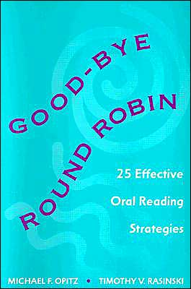
THINK ALOUDS

Slide 2
Oral Reading Strategies
Source: Good-Bye Round Robin 25 Effective Oral Reading Strategies
Notes:
We will practice two oral reading strategies that may take the place of Round Robin Reading and will provide a more detailed list at the end of this section.
Abandon round robin reading because:
Students need time to practice before reading aloud.
It can cause inattentive behaviors, leading to discipline problems.
It does not support self monitoring because often the reader is corrected by others.
It can be a source of anxiety and embarrassment for students.
It can hamper listening comprehension.
It consumes valuable class time that could be spent on other meaningful and more effective activities

Slide 3
Oral Reading: Think Alouds
Teachers verbalizes their thoughts while reading aloud
Modeling and demonstrating what good readers do
questioning the text
self monitoring through rereading
Linking what is being read to prior knowledge
Source: adapted from: Good-bye Round Robin by Opitz & Rasinski
Notes:
Think Alouds and the process described over the next few slides are a way of replacing Round Robin Reading.

Slide 4
Think Alouds
Once the teacher has completed reading orally, and thinking aloud, invite students to add their thoughts.
Pair up students and have them practice the procedure with one another. Students take turns reading and responding to the other.
Ask students to use the procedure when they are reading silently. Students can use a form or a bookmark to remind themselves of what they need to be doing to ensure comprehension and to evaluate themselves.
Source: Good-bye Round Robin by Opitz & Rasinski

Slide 5
Think Aloud form or bookmark
How Did I Do When Reading?
 | NEVER | SOMETIMES | A LOT
I made predictions.
2. I was able to form a picture in my mind.
3. I made connections.
4. I knew when I was having problems
5. I did something to fix my problems.

Slide 6
Abandon round robin reading because:
Students need time to practice before reading aloud.
It can cause inattentive behaviors, leading to discipline problems.
It does not support self monitoring because often the reader is corrected by others.
It can be a source of anxiety and embarrassment for students.
It can hamper listening comprehension.
It consumes valuable class time that could be spent on other meaningful and more effective activities

Slide 7
Reading Comprehension New Year’s Resolutions

Slide 8
As a reading teacher, I will do the following when working with students reading text in my classroom:
1) I will read text selections before the students so that I can encourage them to find the explicit and implied meanings and author’s purpose, particularly of difficult texts.
2) I will be purposeful in building background knowledge, so that my focus is connecting my students to the most important and relevant aspects of the text.
3) I will not distract students during reading by focusing attention on obscure words or unimportant details, but I will keep a spotlight on the essential ideas in the text.

Slide 9
Reading Comprehension Resolutions continued…….
4) I will make my students do the work by not spoon feeding them what a text says, but making them find the meaning on their own through summarizing and paraphrasing in their own words and pushing them to think deeper about the meaning and structure of the text.
5) I will work with students to revisit texts by going back to earlier ideas as we read new texts and discussing similar and contrasting themes and characters

