Slide 1
Text Talk Isabel Beck and Margaret McKeown
Reading at the River

Slide 2
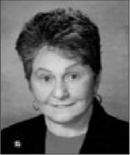
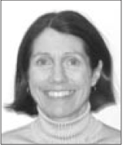
Text Talk Authors
Margaret McKeown, Ph.D.
Isabel Beck, Ph.D.
“An instructional approach to read-alouds that is designed to enhance young children’s ability to construct meaning from decontextualized text. Including comprehension development and language development.” Beck and Mckeown(2001)

Slide 3
TEXT TALK
Text talk is a supplemental curriculum of robust vocabulary instruction developed by Dr. Isabel Beck and Dr. Margaret McKeown to address the significant “word poverty” occurring in our nation’s classrooms today. This vocabulary gap is anticipated to widen and transfer into the ultimate goal of reading—comprehending the meaning of text. Research has revealed that that Text Talk promotes the development of vocabulary and reading comprehension in primary-grade students and may contribute to a closing of the gap.

Slide 4
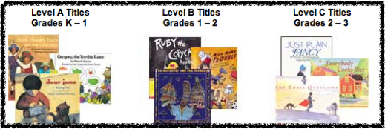
Text Talk
Books chosen were intellectually interesting and provide a valuable interest to explore ideas and use the language to explain their ideas.
Stories with come complexity of events, subtleties in expressing ideas, or presentation of unfamiliar ideas and topics.

Slide 5
Components of a Text Talk
Initial Questions
Follow-up Questions
Vocabulary

Slide 6
Open Ended Questions
Developed questions that initiate discussions at important points in story.
These questions will require children to describe and explain text ideas instead of recall and retrieve words from text.
“How does what Harry did fit in with what we already know about him?”
“What’s Harry up to now?”

Slide 7
Follow-up Questions
The goal is to help children construct meaning.
We might have to take cues from their initial response in order to develop elaborated constructed responses.
Requires effort in creating thoughtful follow-up questions to support students’ construction of meaning.

Slide 8
Pictures
Pictures are not shown to children so they can construct their idea from the text language.

Slide 9
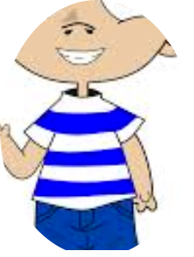
Background Knowledge
I remember
when I got dirty
in the mud!
Teachers need to be able to help children sort out the difference between responding from background knowledge to story information.

Slide 10
Vocabulary
except:
In the beginning of the story,
Harry liked everything except getting a bath.
Except means “with the exclusion of; other than; but: everyone except me”.
Say the word.. except.
Like in the book, Harry liked everything except taking a bath. I am going to read you the beginnings of some sentences and you are going to make up the last part of the sentence that fits with the word, except.
I wanted to eat something, except…
I would buy me a new bike, except that…
I like it when my friend comes over, except…
What’s our word? except
Trade books are great sources of vocabulary.
A word is a good candidate if it seems unfamiliar to children but is a concept they could identify and use in normal conversation.
Instructional activities begin by how the word is used in the story. Children are then involved with using and responding to the use of the word.

Slide 11
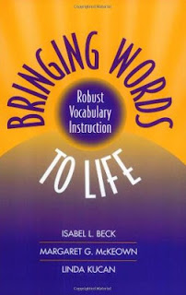
Text Talk
We had a great discussion, which reminded me of Beck's book, Bringing Words to Life. Odds are, you have a copy in your professional library at school, or can access it through your local public library. It's definitely worth reading, as it will give you a new perspective on the power of a read-aloud. Try a goal of purposefully introducing tier 2 vocabulary weekly through a read-aloud, and you will be amazed at the results!!! :)

Slide 12
Text Talk
Scholastic bought the Text Talks designed by Beck & McKeown.
Can purchase the books with the lessons.
http://teacher.scholastic.com/products/texttalk/pdfs/Brochure.pdf

