Slide 1
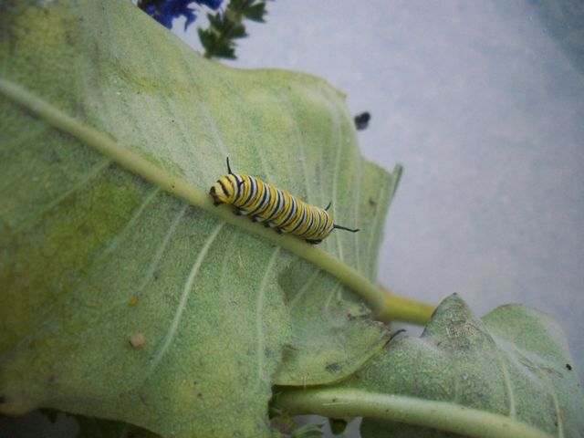
Summarizing a Story
A guide for students

Slide 2
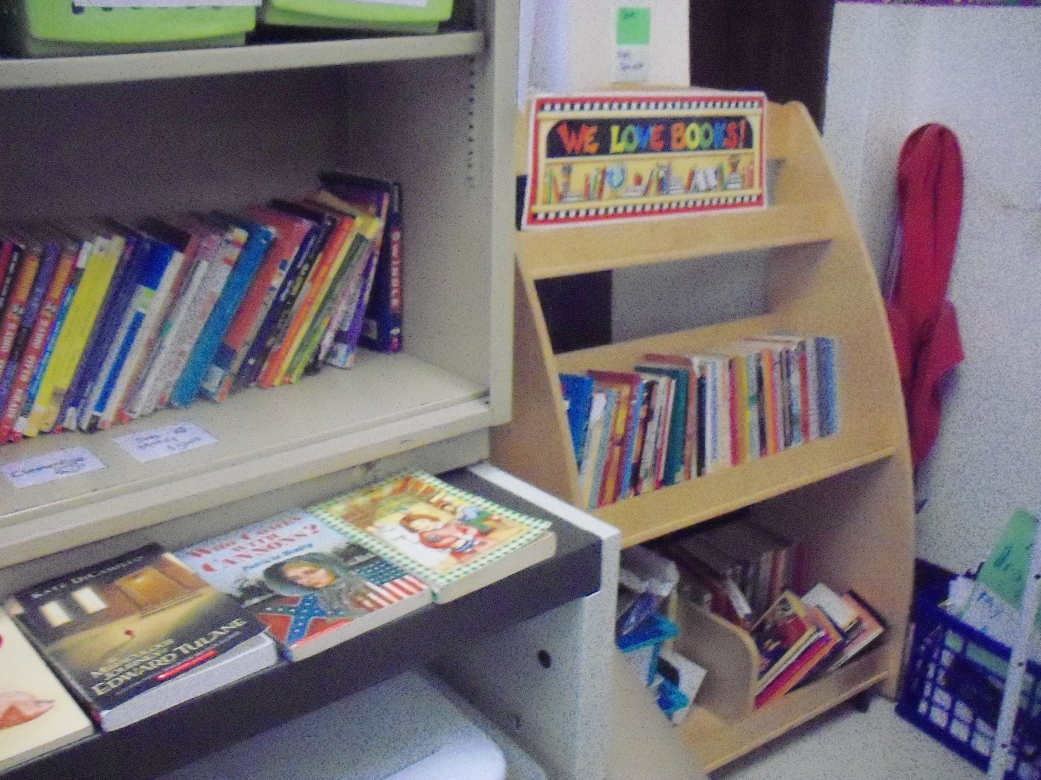
For this presentation, you will need:
A partner
A pencil
A place to record your ideas
*Your teacher will need a copy of The Very Hungry Caterpillar
Notes:
Teacher: You will need a copy of the Eric Carle book The Very Hungry Caterpillar.

Slide 3
What is a summary?
Which best describes a summary?
A really long and detailed piece of writing
The entire text, told in your own words
A dumb thing that teachers make you write
The main ideas and important details of a text

Slide 4
What is a summary?
Which best describes a summary?
D. The main ideas and important details of a text

Slide 5
How do I write a summary?
Sometimes, it’s best to think first about how NOT to write a summary
On the next few slides, you will see some strategies for summarizing that are NOT successful!

Slide 6
Bad strategy #1:
Copy and delete
In this strategy, you just copy a few of the ideas from the text, writing a few sentences and deleting (taking out) a few sentences

Slide 7
Bad strategy #2:
Write down everything
In this strategy, you include every single detail and everything that happens from the story in no order just putting down every single idea and it goes on and on and you run out of room because you just keep wri..
Notes:
This kind of summary is what students do when they have trouble understanding the difference between what is important and what is not important.

Slide 8
Bad strategy #3:
Do as little as possible
This creates a very short summary. You just put down one sentence that has very little detail:
This story was about a girl and a magical trip.

Slide 9
So what’s a good strategy?
A good summary of fiction includes:
  Characters
  Setting
  Important events and details from the plot, in order

Slide 10
A summary is NOT a review
In your summary, just include what the author put in the story.
You do not write your own opinions, like “This was a great book!”
Do not leave a cliffhanger ending, like “If you want to know what happens, read the book!”

Slide 11
How long does it have to be?
Answer: Long enough!
Really, it depends on the story and your purpose for writing the summary.
If you are given lines for writing a summary, a good rule of thumb is to try to fill up at least three quarters of the lines.
Notes:
You may want to show students the Library of Congress summaries on the copyright page of most books. These are the most succinct, shortest summaries around. On the other hand, longer summaries are often required in school.

Slide 12
Talk about it!
With your partner, answer this question:
Have you ever used an unsuccessful strategy for summarizing?
What should a good summary contain?
Notes:
Students in my class are surprisingly eager to share their past academic misdeeds. If you listen to student explanations, you can gain some insight into what students are thinking. (For example, I heard one boy tell another, “I just write down every other sentence.”)

Slide 13
Now, some practice
Listen as your teacher reads aloud The Very Hungry Caterpillar. After the story, you and your partner will choose the best summary.
Notes:
Even though The Very Hungry Caterpillar is a very simple book, it lends itself quite well to this activity. It is a short book that can be read quickly.

Slide 14
Which is the best summary of the story?
Write 1, 2, and 3 on your paper. After you read each summary, either circle it (if it is a good summary) or cross it out (if it is a poor summary)

Slide 15
Which is the best summary of the story?
Summary #1
A bug comes out of an egg. It eats lots of food. This is a great book. If you want to find out how it ends, you should read it!

Slide 16
Which is the best summary of the story?
Summary #2
A caterpillar hatches from an egg. After eating many different kinds of food, it turns into a beautiful butterfly.

Slide 17
Which is the best summary of the story?
Summary #3
In the warm moonlight, a caterpillar hatches out of an egg. First it eats an apple. Then it eats a pear. Then it eats three plums. Then it eats four strawberries. Then it eats five oranges. Then it eats lots of other things. Finally it spins a cocoon around itself. It turns into a beautiful butterfly!

Slide 18
Talk with your partner
Which summary did you think was best? Why?

Slide 19
Which is the best summary of the story?
Summary #1
A bug comes out of an egg. It eats lots of food. This is a great book. If you want to find out how it ends, you should read it!
This summary includes personal opinions. It is also inaccurate—a bug does not come out of the egg, a caterpillar does.

Slide 20
Which is the best summary of the story?
Summary #1
A bug comes out of an egg. It eats lots of food. This is a great book. If you want to find out how it ends, you should read it!
This summary includes personal opinions. It is also inaccurate—a bug does not come out of the egg, a caterpillar does.

Slide 21
Which is the best summary of the story?
Summary #3
In the warm moonlight, a caterpillar hatches out of an egg. First it eats an apple. Then it eats a pear. Then it eats three plums. Then it eats four strawberries. Then it eats five oranges. Then it eats lots of other things. Finally it spins a cocoon around itself. It turns into a beautiful butterfly!
This summary contains more details than are needed. The list of “apple, pear, plums, strawberries, and oranges” can be collapsed into “fruits” or “different kinds of food”.

Slide 22
Which is the best summary of the story?
Summary #3
In the warm moonlight, a caterpillar hatches out of an egg. First it eats an apple. Then it eats a pear. Then it eats three plums. Then it eats four strawberries. Then it eats five oranges. Then it eats lots of other things. Finally it spins a cocoon around itself. It turns into a beautiful butterfly!
This summary contains more details than are needed. The list of “apple, pear, plums, strawberries, and oranges” can be collapsed into “fruits” or “different kinds of food”.

Slide 23
Which is the best summary of the story?
Summary #2
A caterpillar hatches from an egg. After eating many different kinds of food, it turns into a beautiful butterfly.
This summary includes the main character of the story, as well as the important events. It does not include trivial details or opinions.

Slide 24
Which is the best summary of the story?
Summary #2
A caterpillar hatches from an egg. After eating many different kinds of food, it turns into a beautiful butterfly.
This summary includes the main character of the story, as well as the important events. It does not include trivial details or opinions.
This is the best summary!

Slide 25
Review
Write answers to these questions on your paper.
What should a summary of a story include?
What should you avoid including in a summary?

Slide 26
Share with your partner
With your partner, discuss the answers to the questions. Be ready to share your ideas with the rest of the class!
Notes:
Emily Kissner 2011

