Slide 1
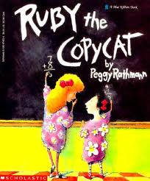
Ruby the Copycat by Peggy Rathmann
Robust Vocabulary
Created by Ms. Wisener

Slide 2
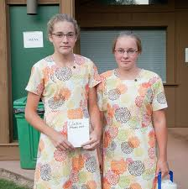
coincidence
A coincidence is when two things happen at the same time but not on purpose.
If you and a friend wore the same clothes on the same day, would that be a coincidence? Explain.

Slide 3
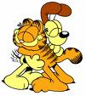
loyal
Someone who is loyal stands by you in good times and bad.
How would a loyal friend behave?

Slide 4
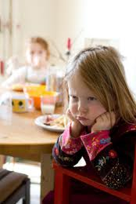
bitter
You are upset at someone or something and keep feeling that way.
Have you ever felt bitter when someone teased you or made you mad?

Slide 5
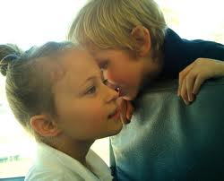
murmur
When people murmur, they speak so softly that they can hardly be heard.
1
Which one of our Scobee voice levels is the same as a murmur?
whisper

Slide 6
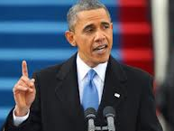
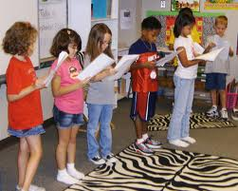
recited
If you recited something, you memorized it and talked out loud in front of people.
When have you recited something in front of other people?

Slide 7
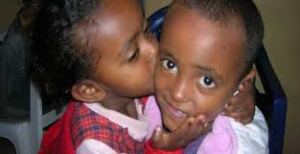
sensitive
You care about the thoughts and feelings of other people.
Which would be sensitive: you can tell if your friend is upset or you don’t care if your friend is upset?

Slide 8
Review: Day 1
coincidence
bitter
loyal

Slide 9
Review: Day 2
recited
murmur
sensitive

Slide 10
Vocabulary Review
See the word.
Say the word.
coincidence
loyal
bitter
murmured
recited
sensitive
murmured
1. Talk very softly_______________________
2. Happens at the same time _____________
3. Caring towards others_________________
4. Talked in front of people_______________
5. Always there in good times and bad______
6. Stays upset or mad___________________
coincidence
sensitive
recited
loyal
bitter

Slide 11
Enjoy the Story!
The End!

Slide 12
All images are from google.com
Please use only in your classroom. Thank you.

